Slide 1
Using Machine Learning to Predict Subscription to Bank Term Deposits for Clients
Ramin Rzayev ID447981
Mahammad Jabrayilov ID448034
Salim Abdullayev ID444150
Ulvi Karimli ID444156

Slide 2
Introduction
In this project focused on bank marketing utilizing machine learning, We aim to illustrate how a specific bank can employ predictive analytics to prioritize customers likely to subscribe to a term deposit. The project will progress through the following stages:
Project Definition
Exploration of Data
Feature Engineering
Creation of Training, Validation, and Test Samples
Selection of a Suitable Model
Evaluation of the Chosen Model

Slide 3
Introduction
By analyzing this data, we can identify patterns and factors that influence customers' decisions to subscribe to bank products, such as term deposits. This analysis not only helps in refining marketing approaches but also contributes to better customer segmentation and personalized offerings, which are essential in today's customer-centric business landscape.

Slide 4
Objective
The main goal of our project is to predict customer responses to term deposit campaigns conducted by the bank. By using machine learning models, we aim to forecast whether a customer will subscribe to a term deposit, helping the bank to target potential subscribers more effectively and allocate resources more efficiently.

Slide 5
Methodology Tools Used
Python: The cornerstone of our data manipulation and analysis, Python offers flexibility and powerful libraries tailored for data science, making it an ideal choice for our project.
Pandas: We utilize Pandas extensively for data handling and manipulation. This library provides us with essential data structures and functions to perform operations such as merging, reshaping, selecting, as well as handling missing data efficiently.

Slide 6
Methodology Tools Used
Scikit-learn: This library is a fundamental tool in our machine learning toolkit. Scikit-learn provides a range of supervised and unsupervised learning algorithms via a consistent interface in Python. We will use it primarily for building machine learning models, cross-validation, and various metrics to evaluate model performance.
Matplotlib/Seaborn: For visualization, we will use both Matplotlib and Seaborn to create a variety of plots and charts. Matplotlib allows us comprehensive control over every aspect of our figures, while Seaborn helps us to make attractive and informative statistical graphics quickly.

Slide 7
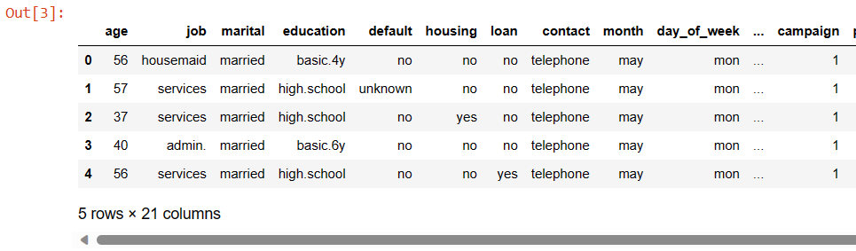
Data Exploration
The dataset utilized in this project originates from the UCI Machine Learning Repository and encompasses data from over 40,000 direct marketing campaigns conducted by a banking institution between May 2008 and November 2010. These campaigns, executed through phone calls, often necessitated multiple contacts with the same client to determine whether the product (bank term deposit) would be subscribed ('yes') or not ('no').

Slide 8

Model Selection
We will first compare the model performance of the following 3 machine learning models using default hyperparameters:
Adaboost
Catboost
Lightgbm

Slide 9
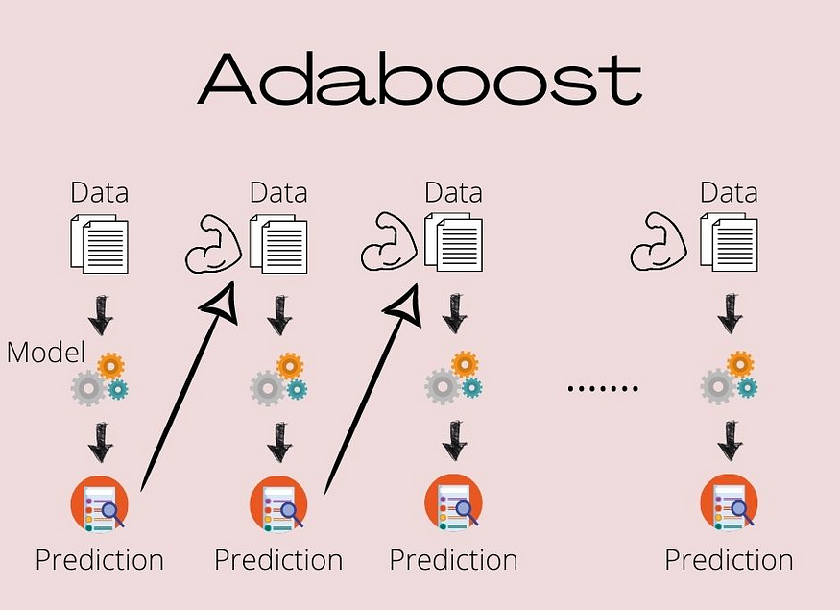
AdaBoost Model
The AdaBoost model is an ensemble learning technique that combines multiple weak learners (in this case, Decision Trees with max depth 1) to create a strong learner. It works by sequentially fitting a series of weak models to the data, with each subsequent model giving more emphasis to the instances that were misclassified by the previous ones.

Slide 10
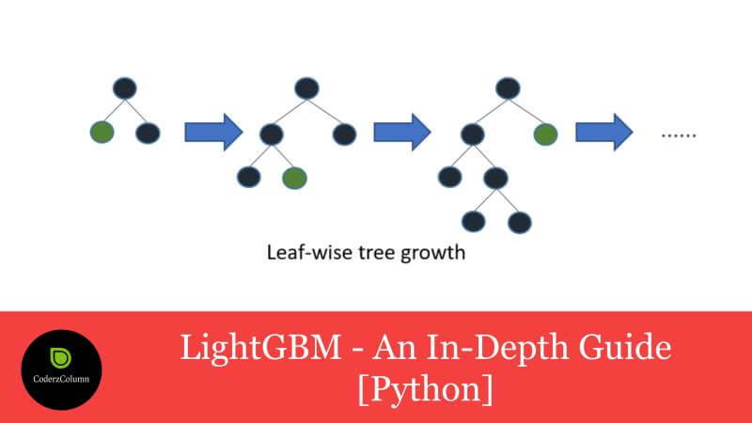
Lightgbm Model
The LightGBM model is a gradient boosting framework that is designed for efficiency and scalability

Slide 11
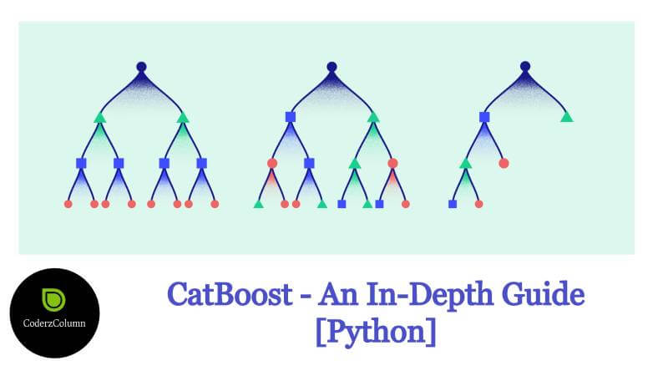
Catboost Model
The CatBoost model is a gradient boosting algorithm that is specifically designed to handle categorical features efficiently.

Slide 12
Responsibilities Ramin Rzayev
Data Preparation and Initial Exploration:
Load and Initial Data Check: Load the dataset and conduct initial checks, including checking for data types and missing values.
Initial Data Analysis: Perform basic statistical analysis to understand the distribution and summary statistics of the data.
Data Cleaning: Address missing values and ensure data quality for further analysis.

Slide 13
Responsibilities Mahammad Jabrayilov
Feature Engineering and Preprocessing:
Categorical Data Handling: Apply one-hot encoding to transform categorical data into a format suitable for modeling.
Feature Scaling: Standardize or normalize numerical features to ensure they contribute equally to the model's performance.
Feature Creation: Develop new features from existing data to improve model predictions based on insights gained from initial data exploration.

Slide 14
Responsibilities Salim Abdullayev
Model Training and Evaluation:
Data Splitting: Split the data into training, validation, and test sets to ensure robust evaluation.
Model Training: Train various machine learning models, tuning hyperparameters as necessary.
Model Evaluation: Assess model performance using metrics like accuracy, precision, recall, and AUC.

Slide 15
Responsibilities Ulvi Karimli
Advanced Model Tuning and Deployment:
Advanced Model Tuning: Use techniques like grid search to find optimal model settings.
Algorithm Testing: Experiment with different machine learning algorithms to identify the best performer for the specific dataset.
Model Deployment Preparation: Prepare models for deployment by ensuring they are saved properly and can be loaded for future use or real-time predictions.

Slide 16
THANK YOU!

